Slide 1
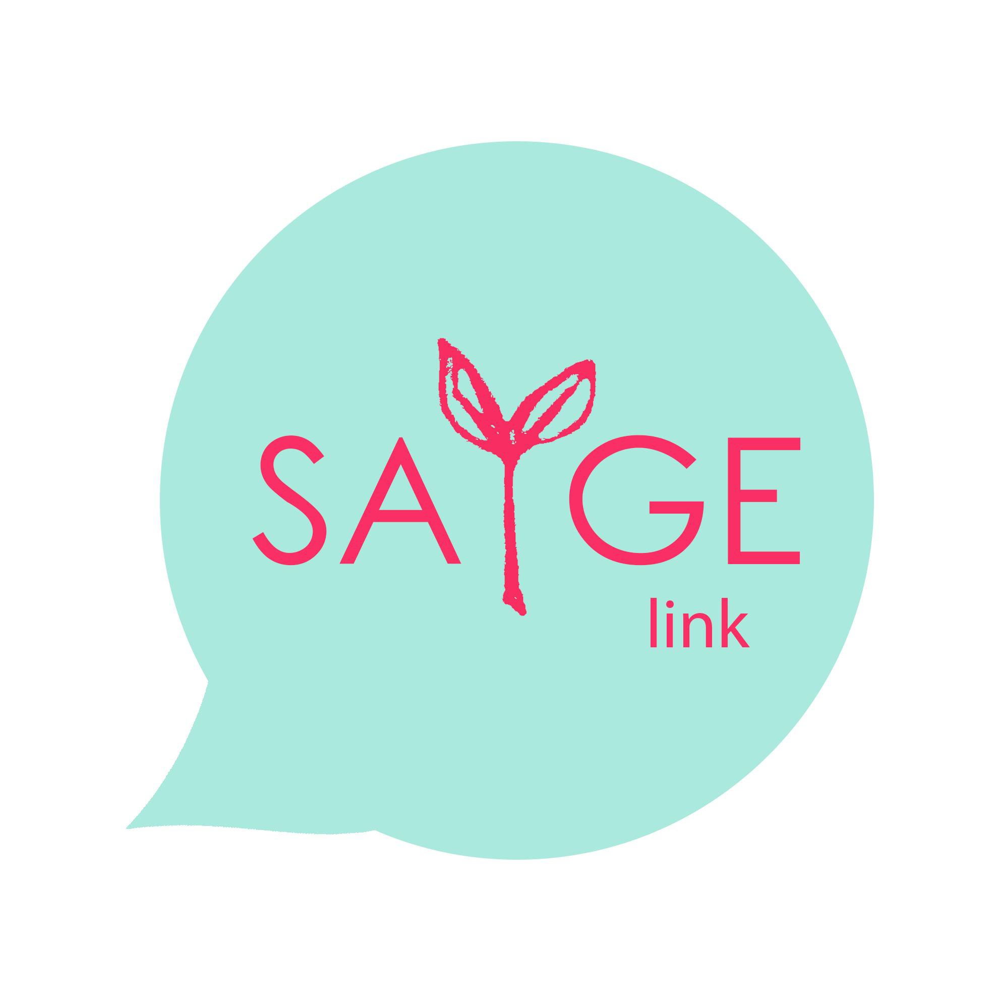
SAYge Link
Private Networks
App Design

Slide 2
About
SAYge Link is a digital peer support network that harnesses the value in shared lived experiences, facilitating access to meaningful insight through matched connection.
Mission is to provide an authentic network of shared understanding to support and empower!
How –by enhancing the current product:
My plan : to understands the current product and rapid enhancements to ensure brand awareness , trust and user experience through and developing an app where consumers and institutions can build a community,

Slide 3
Goal
To provide SAYge Link Private Networks to organizations wishing to facilitate valuable connection, peer support, micro-mentorship and community within their organizations - easily.
SAYge Private Networks are created and customized for each organization’s needs and goals. The versatile private platform offers tailored connection topics, branding and features that will meet the goals of each organization.

Slide 4
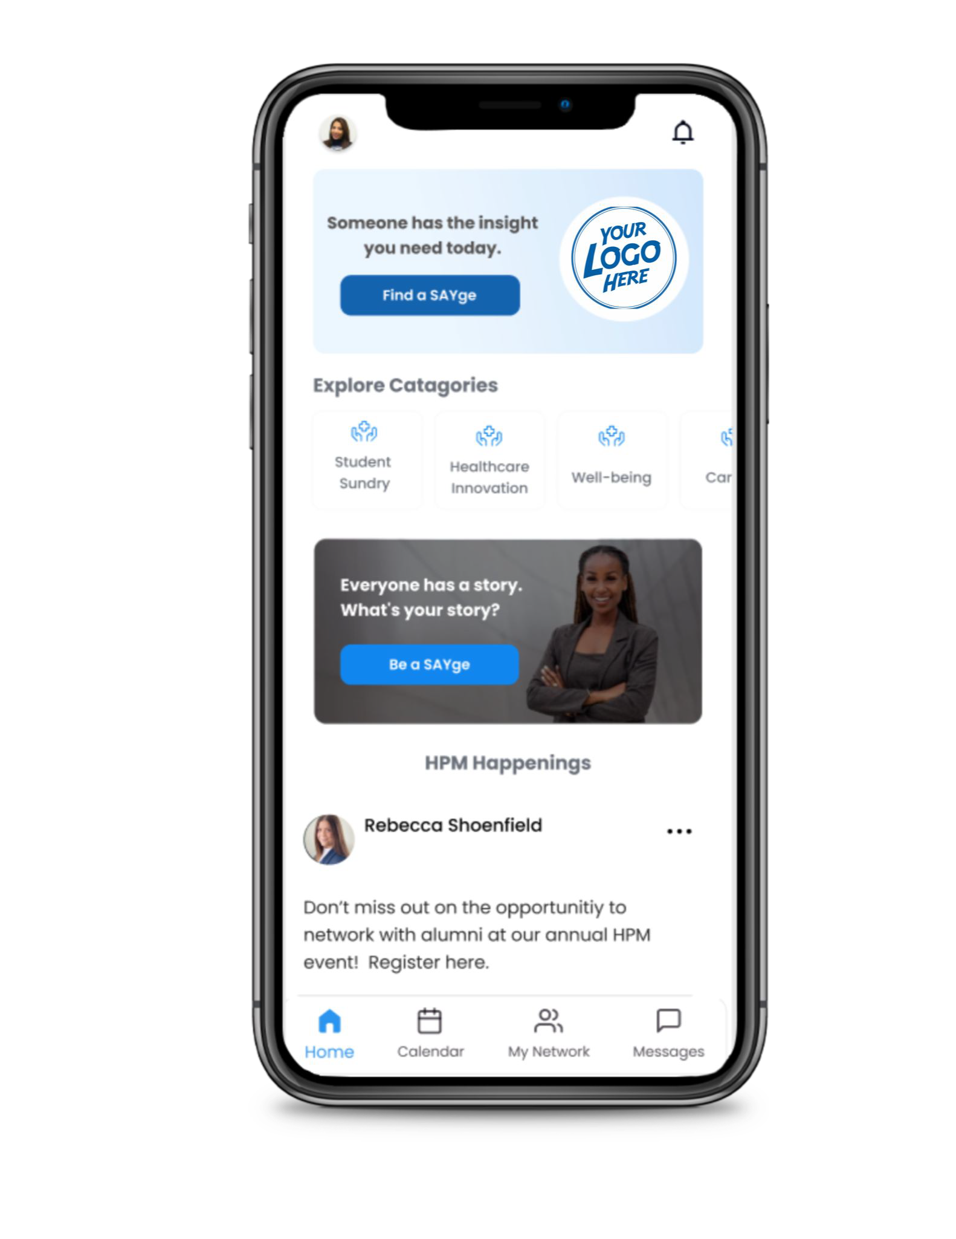
Features
White label solution –branding opportunity
IOs and Android capable mobile app
Users: Private member access/Admin access
Connection categories and topics chosen by organization
Topic-based matched connection between members
Homepage community board
Groups
DM, phone/video call scheduling
Calendar to view and join scheduled calls
Notiﬁcations

Slide 5
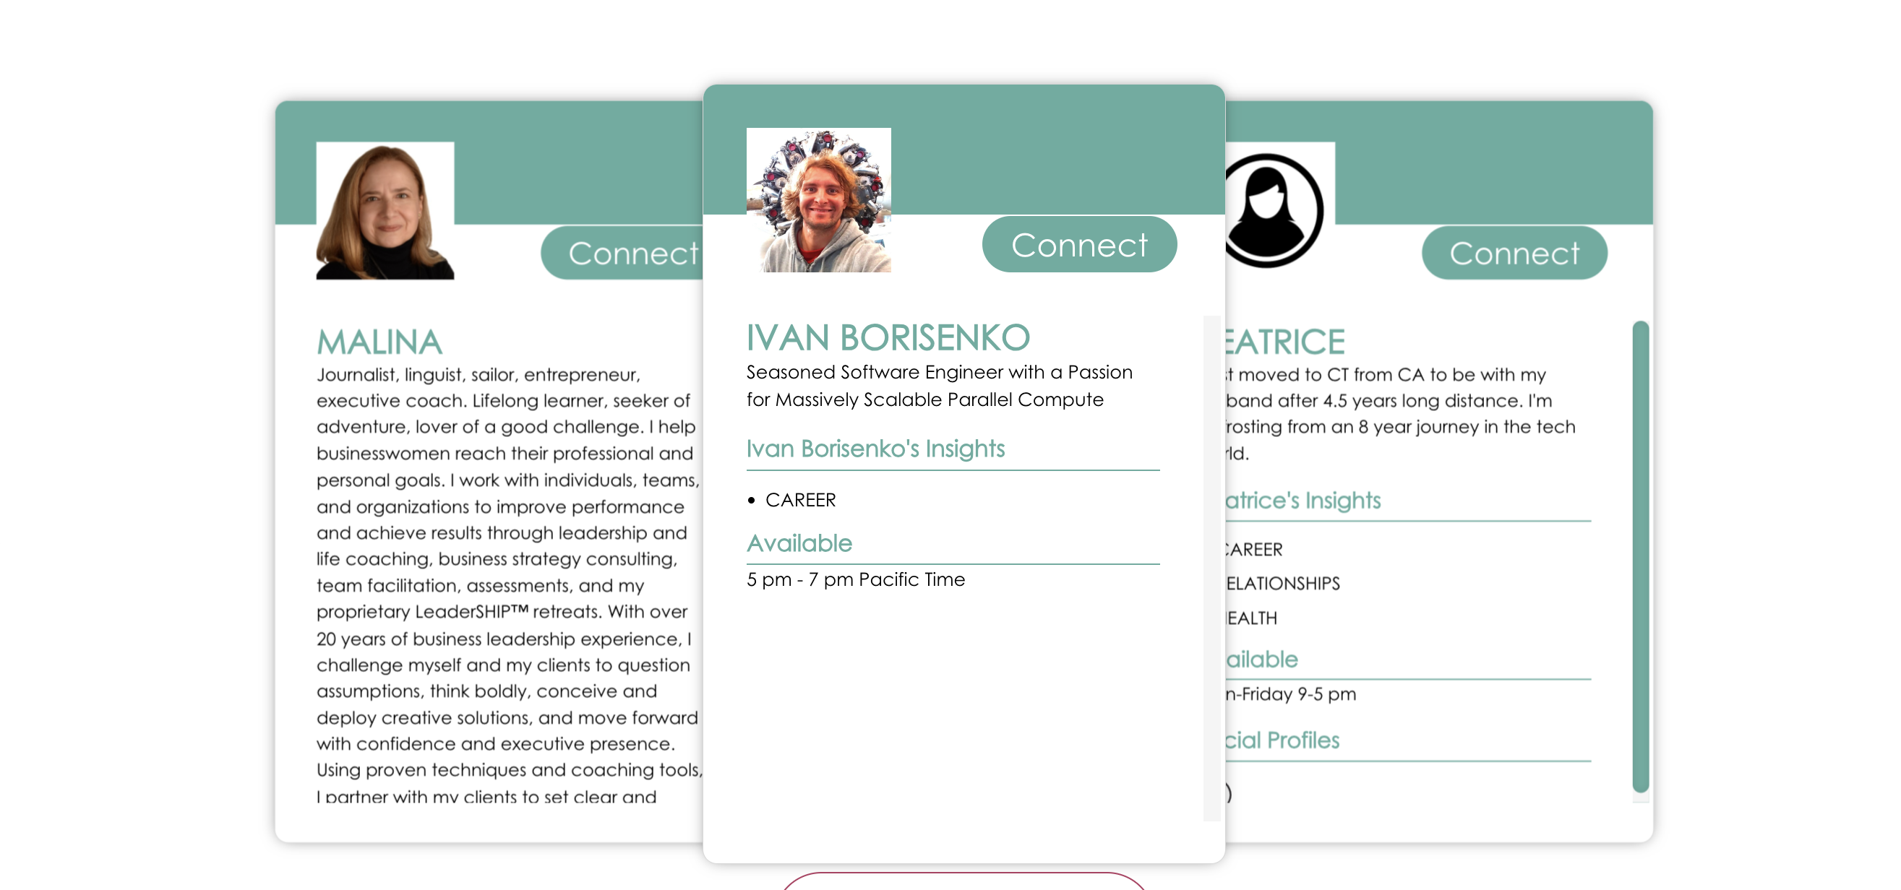
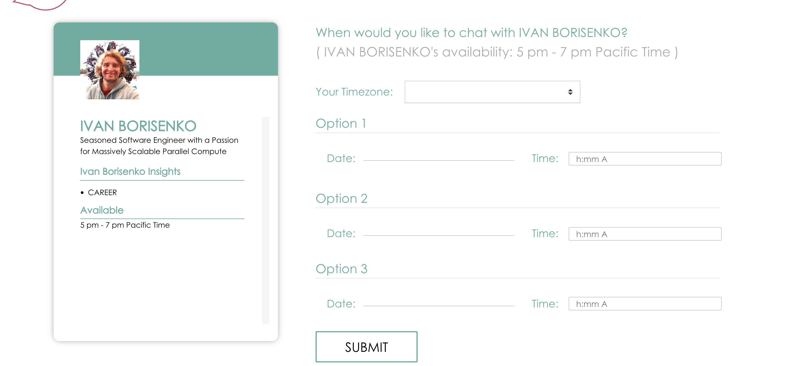
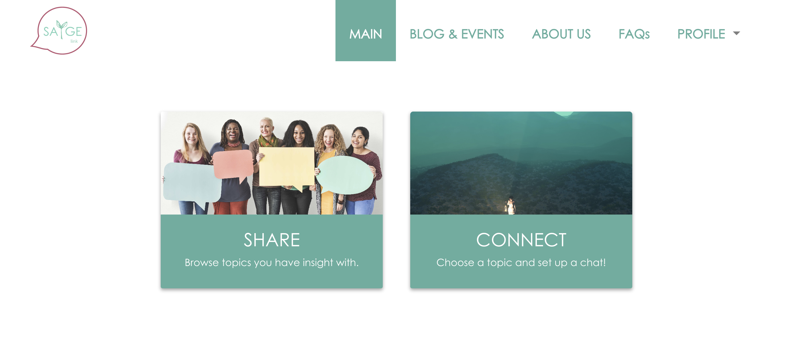
Before
Landing Page:
Clear message and branding
Onboarding:
Clear navigation
Smooth profile creation
Feed
Scheduling layout
SAYge Link

Slide 6
Use Case
School of Public Health, departmental network
To connect students:students and students:alumni in a valuable way, all on one platform
Groups: Advisory groups, Job postings, Cohorts, Interest & Event groups
Prototype

Slide 7
“I love how the SAYge Link Network lets me give back and makes it easy for people to connect with me in a targeted way!” Celeste L.
“Formal mentorship programs can be intimidating commitment wise, (SAYge Link) is more targeted and convenient and organic!” Ali L.
Private Network
Testimonials
“SAYge Link is an external bridge to alumni, an internal bridge to the department.” David G.
“As a college student, I am part of a lot of groups that offer mentorship and advice, but I sometimes find it difficult to reach out. This platform helps connect people privately and allow them to develop meaningful connection.” Sandy Q.
“Now I don’t have to send 50 linkedin messages just to have one coffee chat!” - Zerena V.

Slide 8
Thanks for your time!

